Slide 1
TPO CONNECT

Slide 2
TPO Connect Overview
Logging in
Home Page
Registering a New Loan
Pricing and Locking a Loan
Submitting the loan
Uploading Purchase Conditions
Purchase Advices
Pipeline – Loan Summary – Key Dates

Slide 3
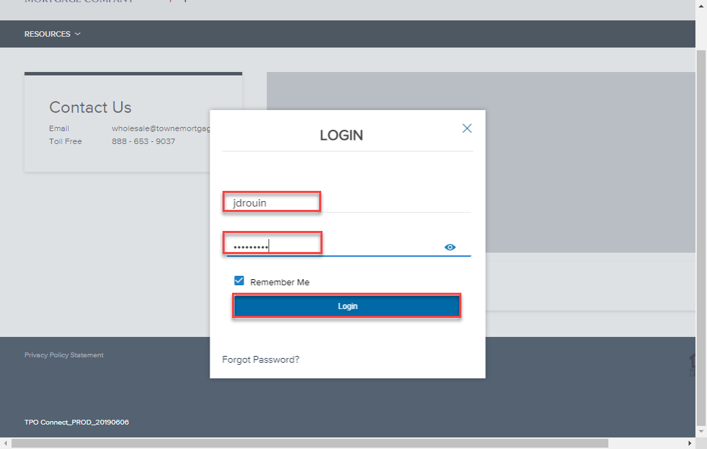
Logging In
Click “Click here to Log In” button.
In the Login Window:
Enter User Name (email)
Enter Password
Click Login

Slide 4
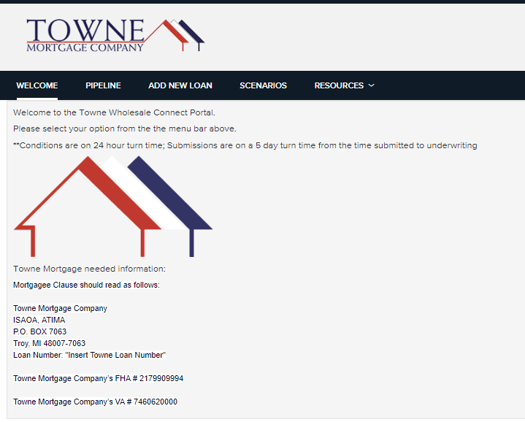
Home Page
Home Page displays 4 tabs.
Welcome Page
Pipeline
Add New Loan
Scenarios
Resources Center

Slide 5
Registering A New Loan
Registering a new loan has never been so easy!

Slide 6
Registering a New Loan
To Register a new loan:
Click “ADD NEW LOAN”
Select the channel: “Correspondent Delegated”

Slide 7
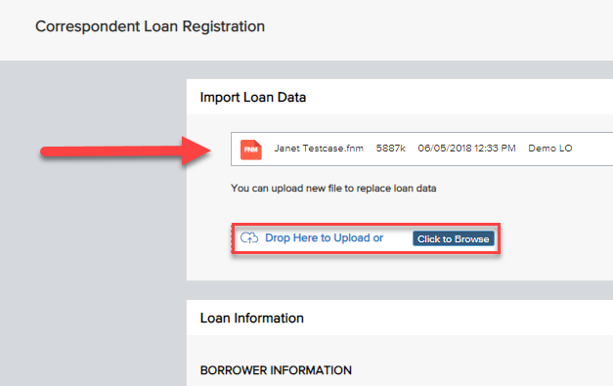
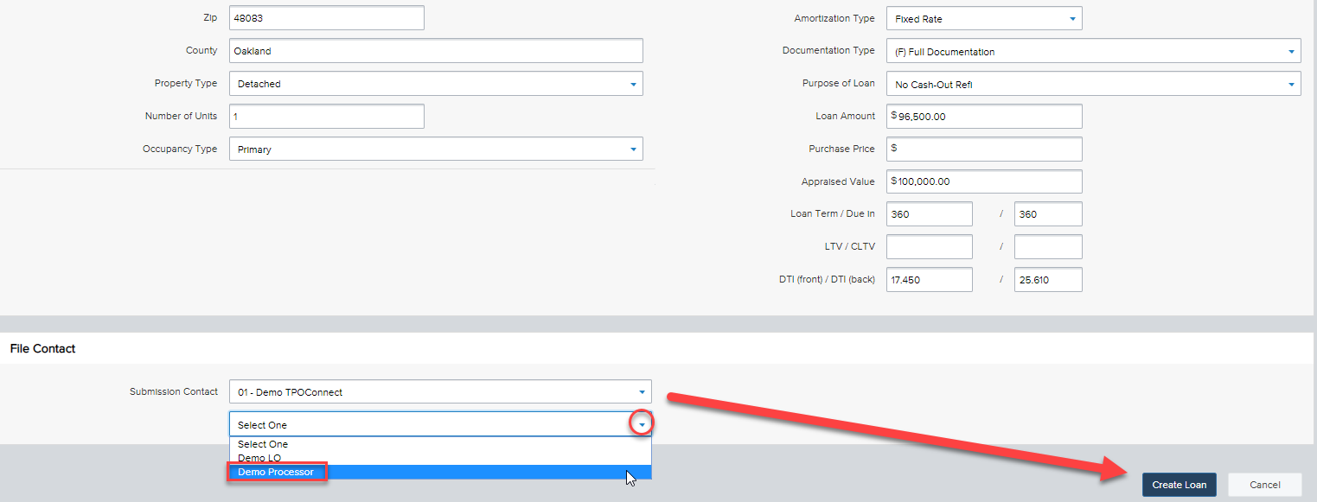
Registering a New Loan
Drag-and-drop, OR Browse-and-Attach your FNM 3.2 file.
You will see the confirmation ribbon of the 3.2 data above.
Select the File Contact from the Dropdown
Click “Create Loan” to Register.

Slide 8
Registered Loan
You will see the Loan banner at the top now displays the Borrower specific criteria to your loan.
On the left-hand side of the screen, there are Tabs to access 1003 data, Product and Pricing, Documents for Submission and Outstanding Conditions; and a section to view Purchase Conditions (after the loan has been reviewed)

Slide 9
Pricing and Locking a Loan
TPO Connect allows you to lock your loan with just a few clicks!

Slide 10
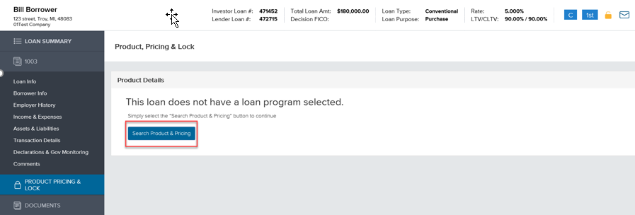
Pricing and Locking a loan
To Access Product and Pricing:
Click Product Pricing and Lock tab.
Click Search Product & Pricing

Slide 11
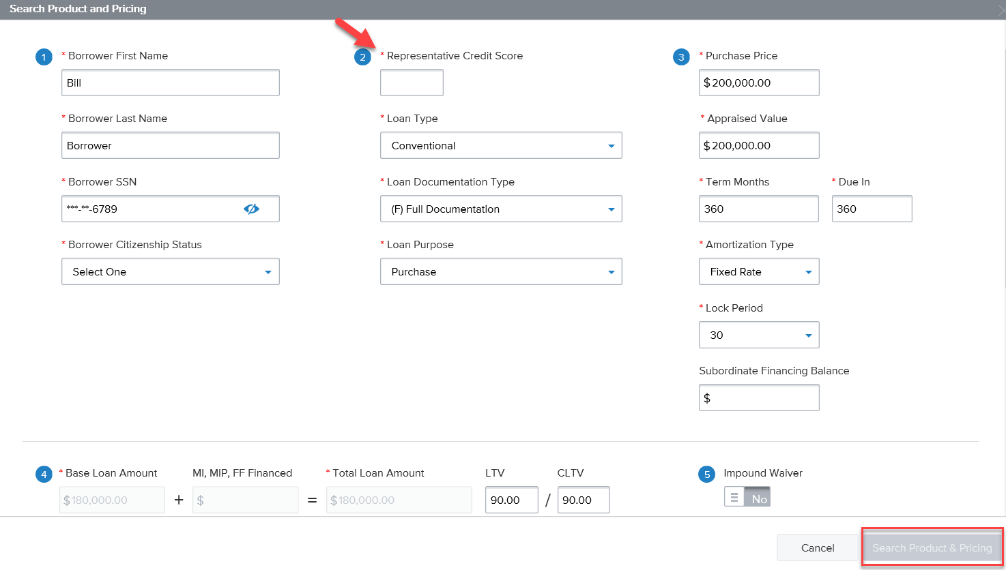
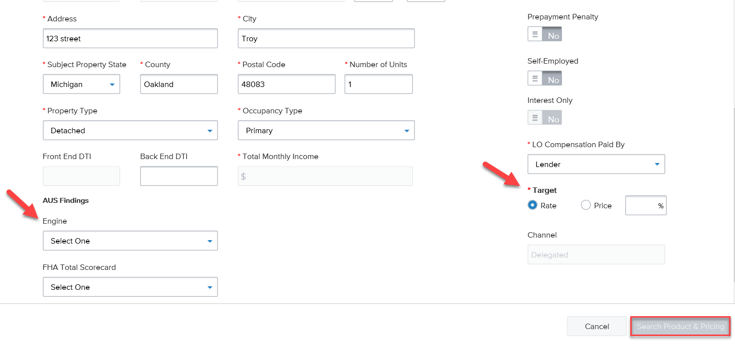
Pricing and Locking a Loan (cont.)
This is the TPO Product & Pricing screen.
You will need to ensure all fields with a red asterisk (*)are completed to proceed;
Target Rate/Target Price is not in the 1003 data and will need to be selected on this screen.
Once all required fields are entered, please click on Search Product and Pricing.

Slide 12
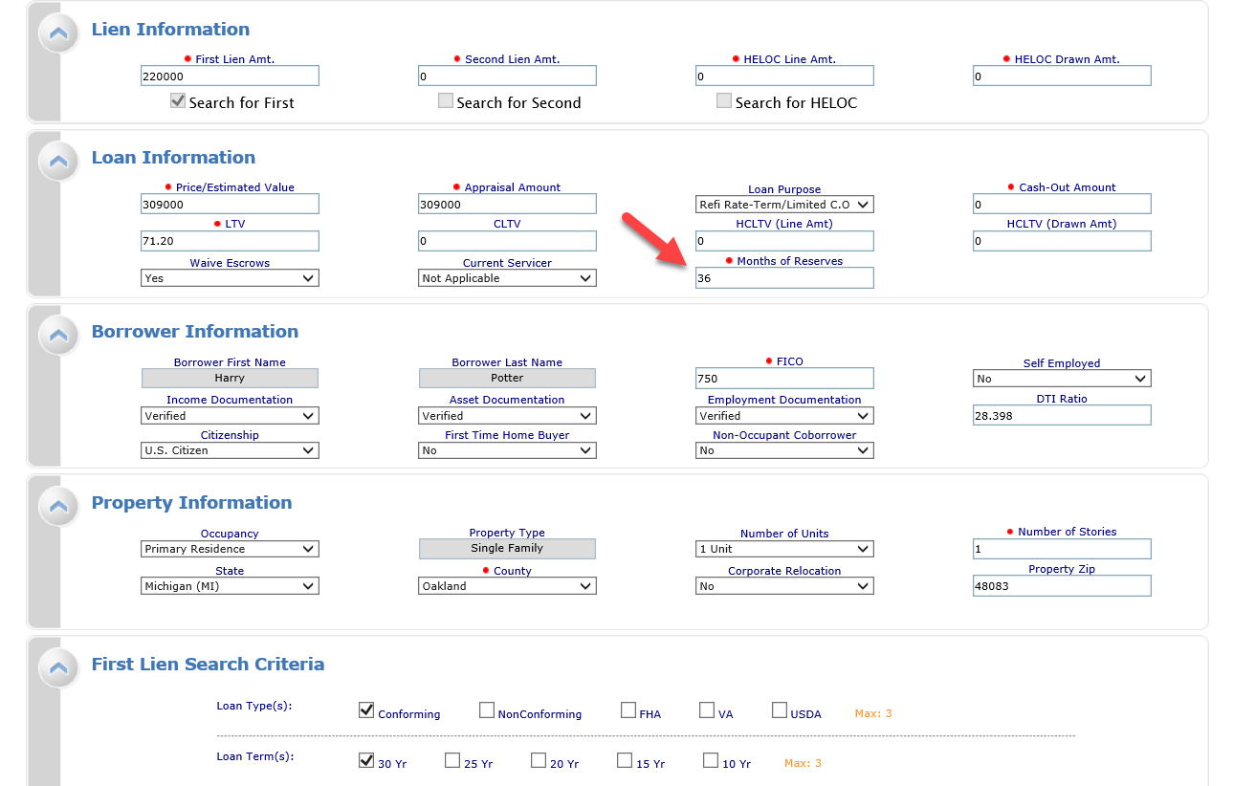
Pricing and Locking a Loan (Cont.)
This is the Optimal Blue product and pricing page.
The required items (shown with *)should flow from the previous screen.
Once confirmed, please click the submit button
Please Note – two data fields - Reserves and AUS, will not flow and need to be confirmed here.

Slide 13
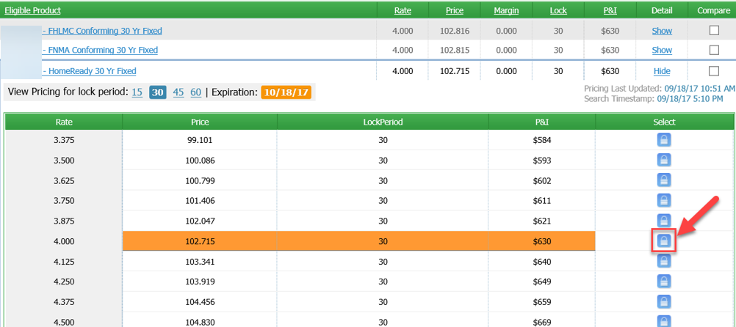
Pricing and Locking a Loan (Cont.)
Please highlight the eligible product and rate for your loan
Click on the lock button to choose the rate and price. (Not locked yet – see next slide)

Slide 14
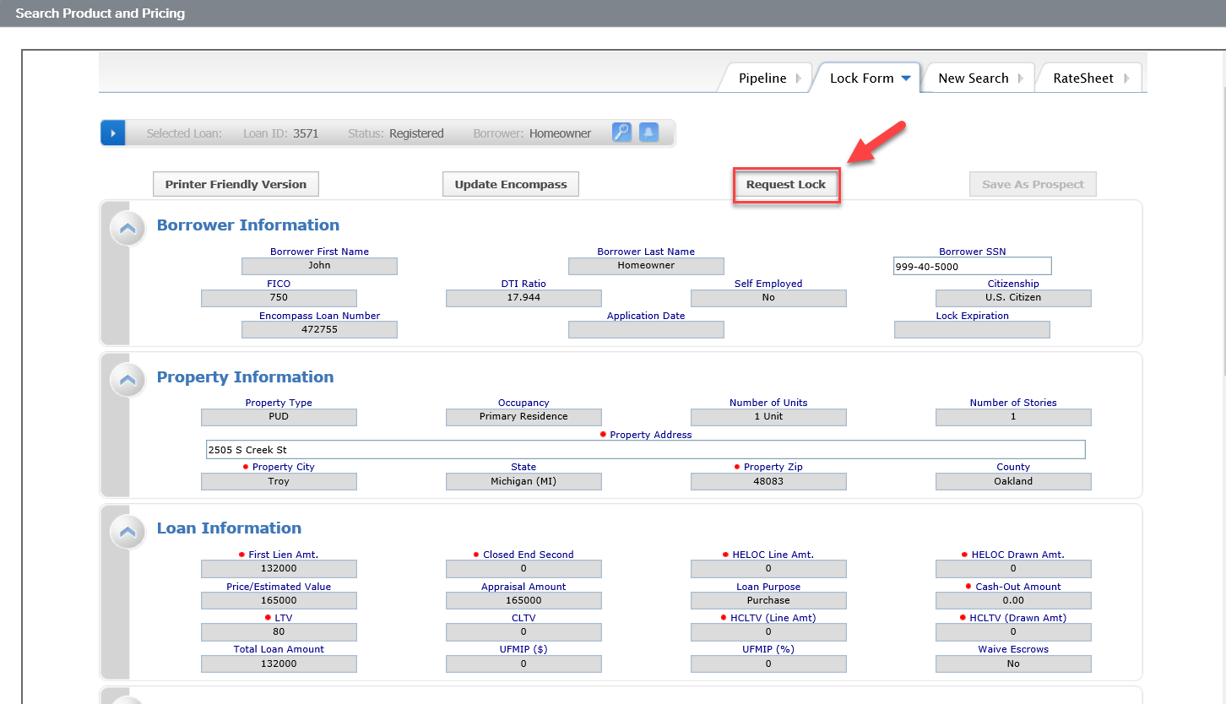
Pricing and Locking a Loan (Cont.)
Review the terms of the Loan and Pricing and click “Request Lock” to confirm the lock.

Slide 15
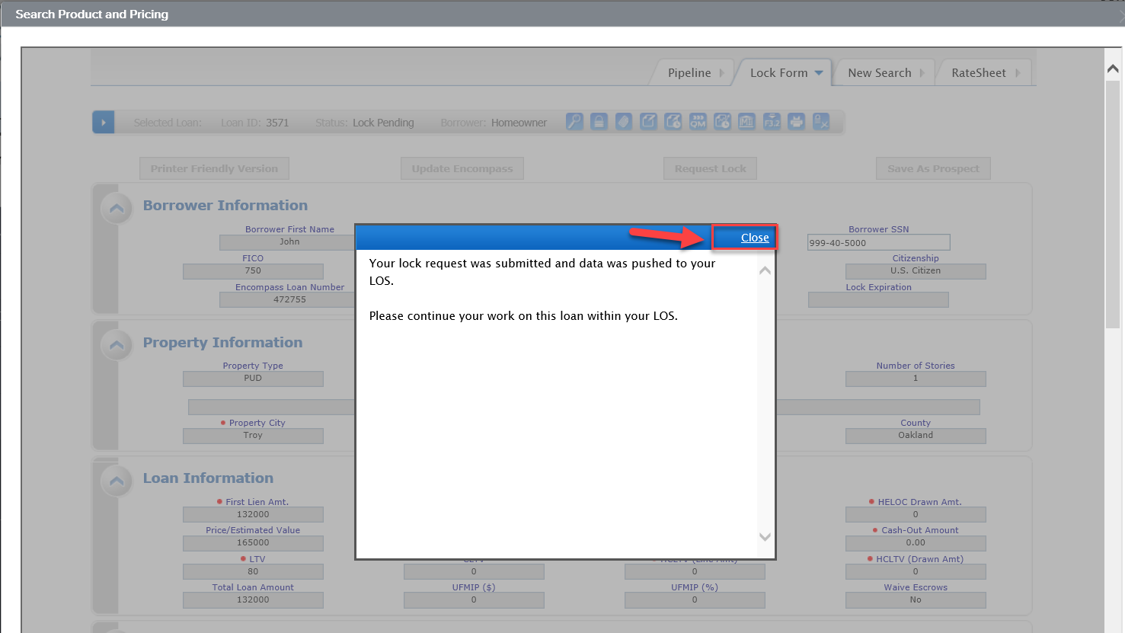
Pricing and Locking a Loan (Cont.)
After you Request Lock, you will receive this pop up.
Click close at the top right hand corner.
Exit the loan by Accessing the pipeline.

Slide 16
Pricing and Locking a Loan (Cont.)
Stay in the Pipeline View and click F5 to refresh the view and see the lock icon turn blue:
This means the lock is confirmed.
Once confirmed, you can re-enter the loan.
NOTE: If you re-enter the loan before confirmation (or fail to exit), the lock will not update the loan since you must allow access for the Product and Pricing User to update and lock your loan.

Slide 17
Submit to Towne for Delegated Correspondent Review
Couple more steps and you can Submit!

Slide 18
Document Delivery/Uploads
Upload the necessary documents needed to Submit for Review:
Access the Documents Tab
Upload the desired documents (based on title) to the following placeholders by “Browse and Attach” or “dragging and dropping”:
Corr: Appraisal
Corr: Closing Package
Corr: Credit Package

Slide 19
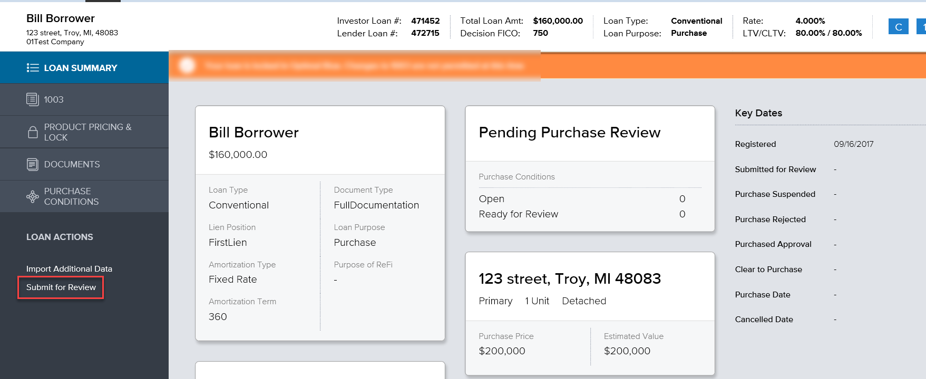
Submit for Initial Review
Click “Submit for Review”
That’s It. Your Done with the Submission Process.

Slide 20
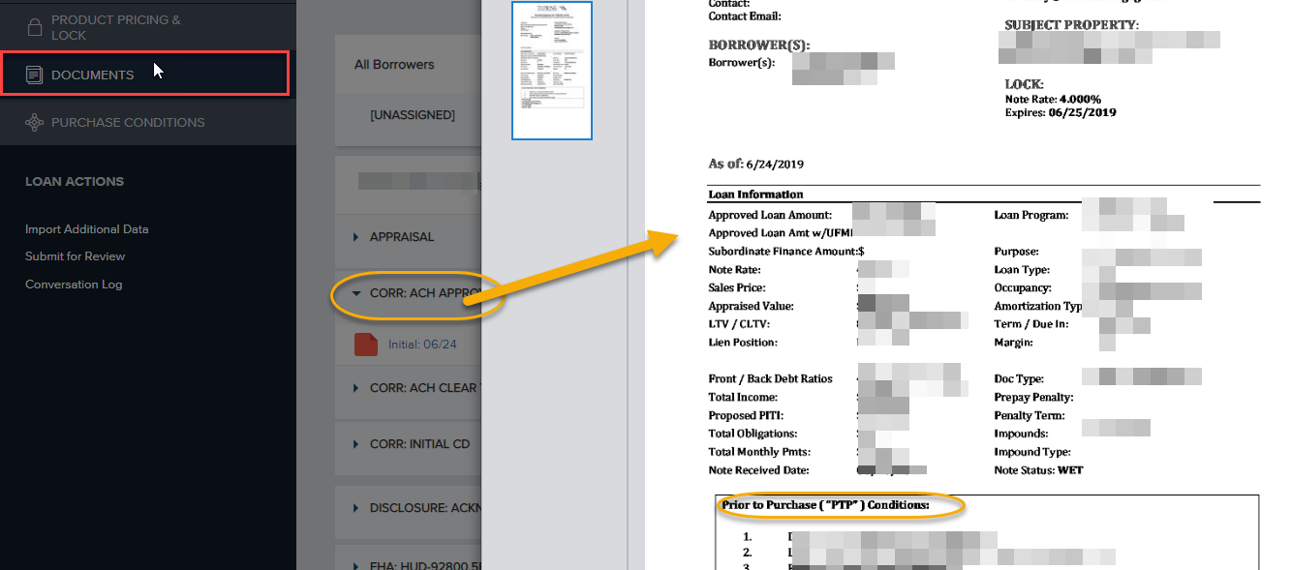
Reviewing Purchase Suspense Conditions
Review your Purchase Suspense by:
Access the Documents Tab:
Review the Corr: Approval for Prior to Purchase (PTP) conditions.

Slide 21
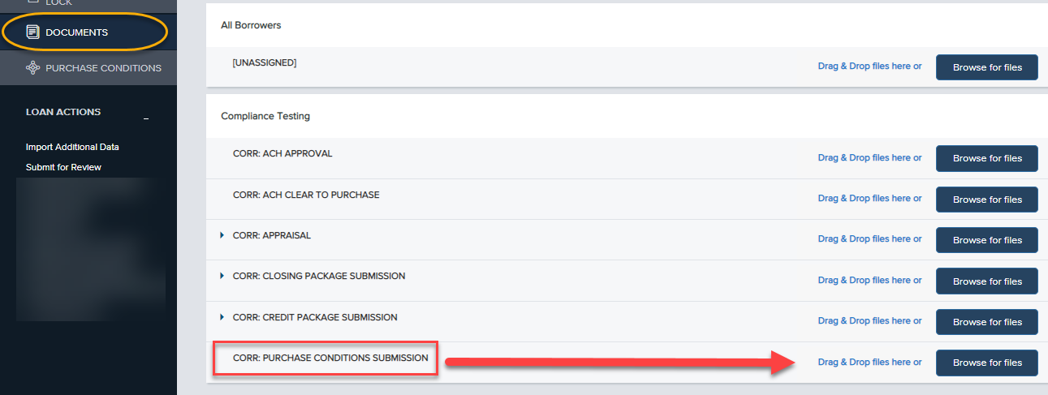
Submitting Purchase Suspense Conditions
To Submit Purchase Suspense Conditions:
Access the Documents Tab:
Upload conditions to the placeholder: “Corr: Purchase Conditions Submission”
Next Access the Purchase Conditions Tab:
Click “Notify Lender”
NOTE: The Purchase Suspense Tab will display the conditions, but the only action taken on this screen is “Notify Lender”.

Slide 22
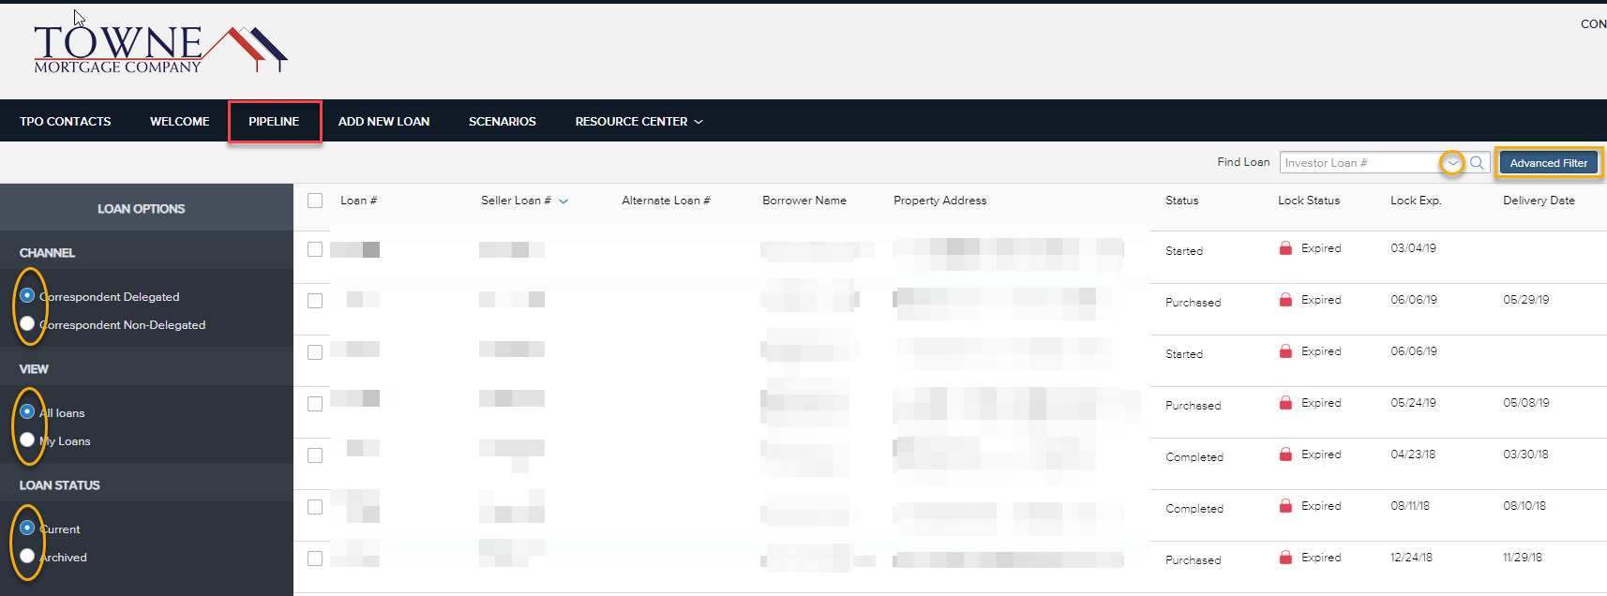
Pipeline View
The TPO Connect Pipeline view will display all of your loans
You will be able to view all the loans you have access to.
You will be able to sort by clicking on any of the column headers
Your can search loans using the “Find Loan” box, OR the Advanced Filter allows a more robust seach function (see next slide)
To view a loan, please click on the loan ribbon and you will be taken to the Loan Summary page (See Slide 16).

Slide 23
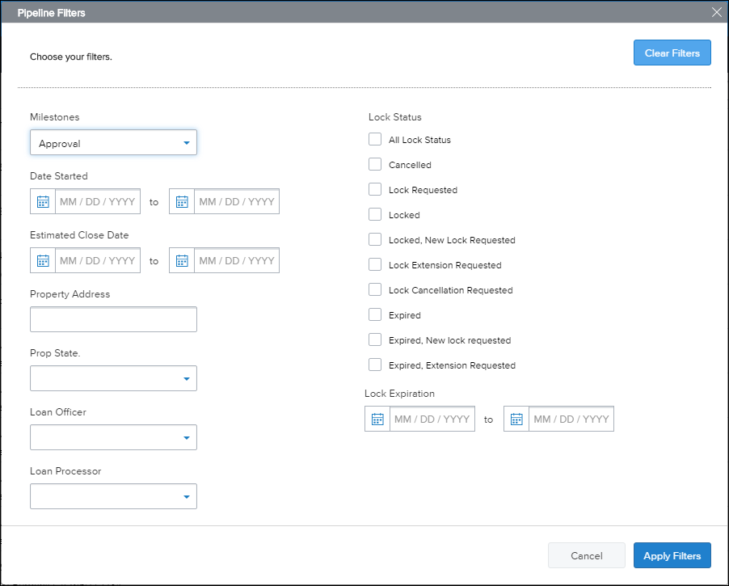
Pipeline Search Using Advanced Filters
The “Advanced Filter” button opens up a window for you to search by a number of specific criteria: Milestones, Lock Status, State, etc.
Be sure to “Clear Filters” at the Top-Right of the window when done searching to ensure normal Pipeline View functionality.

Slide 24
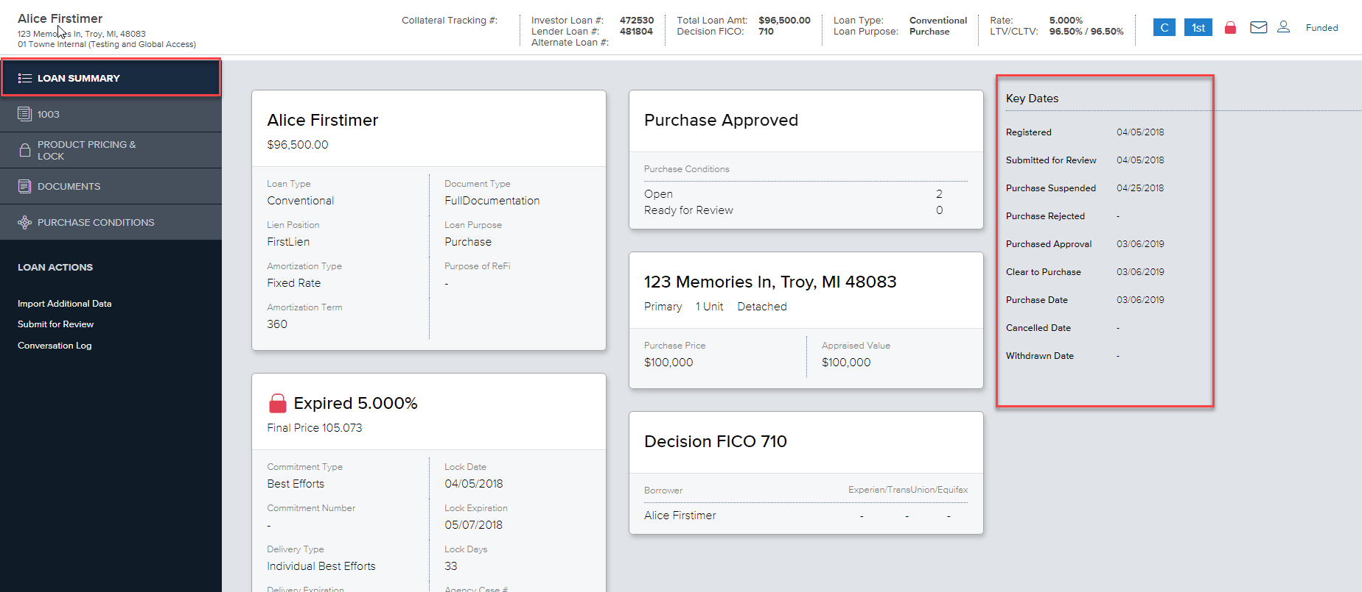
Loan Summary
Loan Summary page lists the detailed information of your loan.
The Key Dates section lists the date a status or Milestone was achieved. (See Slide 26 for information on the Key Date Terms.

Slide 25
Loan Summary – Key Dates
Key Dates
Registered – The loan has been created in TPO connect
Submitted for Review – The loan file is Submitted to Towne for Initial Review.
Purchase Suspended - The loan has been reviewed and conditions requested to clear the loan for Purhcase
Purchase Approval/Clear to Purchase – This is the date Towne clears your loan for purchase.
Purchase Date – This is the date we funded your loan and issued the Purchase Advice
Purchase Rejected – This is the date a loan is rejected and will not be purchased by Towne.
Cancelled Date- The date the Correspondent withdraws their loan.

Slide 26
THANK YOU!

